Slide 1




MARKETING CAMPAIGN CLUSTERING PROJECT
CUSTOMER SEGMENTATION USING MACHINE LEARNING
PRESENTED BY: GROUP -04
Project Date-24-06-24

Slide 2





CONTENT
01
02
03
04
Introduction
Data Understanding and Preparation
Exploratory Data Analysis (EDA)
Clustering for Customer Segmentation
05
06
07
08
Challenges and Solutions
Next Steps and Action Items
Conclusion
Model Deployment

Slide 3




CUSTOMER SEGMENTATION
INTRODUCTION
The aim of this project is to enhance the marketing strategies of a retail company by segmenting customers based on their purchasing behavior and demographic characteristics. By understanding different customer segments, the company can tailor its marketing efforts to meet the needs and preferences of each group, ultimately driving customer satisfaction and boosting sales.

Slide 4





PROJECT OVERVIEW
The Marketing Campaign Clustering Project aims to segment customers based on purchasing behavior using clustering. By analyzing features like income, recency, and product purchases, we identify distinct customer groups to optimize marketing strategies. The project involves data preprocessing, clustering, and deploying the model as a web application using Flask.
Objective
DATASET
TECH STACK
To segment customers based on their purchasing behavior to better target marketing campaigns.
Marketing campaign data with features like income, recency, product purchases, etc.
Python, Matplotlib, Numpy, Seaborn, Flask, Scikit-Learn, Pandas etc

Slide 5

STRATEGIES
01
Understand the data distribution
EDA to understand data distributions, correlations, and potential insights.
02
Exploratory Data Analysis (EDA)
EDA to understand data distributions, correlations, and potential insights.
03
Data Wrangling
Data wrangling, also known as data munging, is the process of cleaning, transforming, and preparing raw data into a usable format for analysis
04
Clustering
Segment customers based on purchasing behavior and demographics
05
Classification
Split the Data: Split the dataset into training and testing sets.
Train a Classification Model,Evaluate the Model, Fine-tune the Model
06
Model Deployment
The model to be deploy using a Flask web application to make it accessible for real-time predictions. The Flask app allows users to input customer data and receive the predicted cluster for that customer.

Slide 6

BUSINESS UNDERSTANDING
Problem Statement
Identify distinct customer segments to optimize marketing strategies.
Goals
The project aims to identify distinct customer segments to enhance marketing effectiveness, boost customer satisfaction, and maximize return on investment. By understanding purchasing behaviors and preferences, the goal is to create targeted marketing campaigns that better address the needs and characteristics of different customer groups.
We have a team of professionals

Slide 7




EXPLORATORY DATA ANALYSIS (EDA)
Purpose of EDA
Understand the data distribution
Identify patterns, relationships, and anomalies
Prepare data for clustering
Data preparation for clustering involves handling missing values, normalizing numerical features, encoding categorical variables, and removing outliers to ensure clean, standardized input for accurate cluster analysis and interpretation.
Loaded the dataset and inspected the structure.
Identified key features like income, recency, product purchases, etc.
The dataset reveals key patterns in customer demographics and behavior, such as income and recency influencing segmentation. Relationships between features like age and spending habits are evident. Anomalies include outliers in income and extremely recent purchases, indicating potential data entry errors or unique customer behaviors needing further investigation.

Slide 8

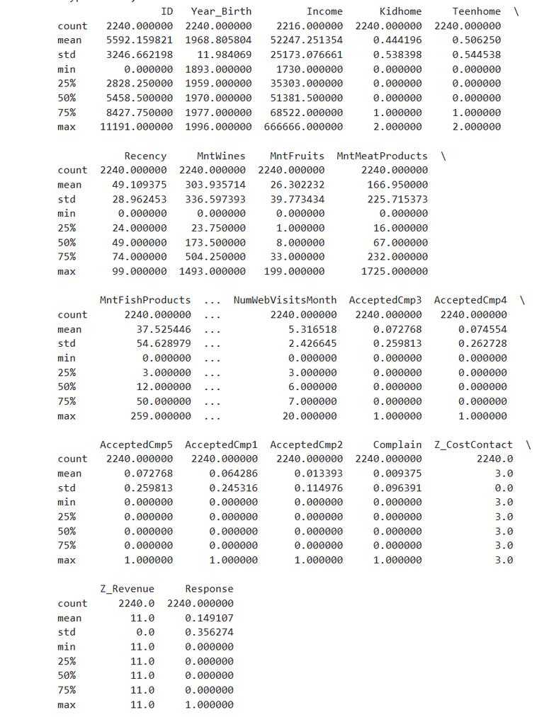
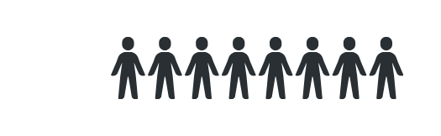
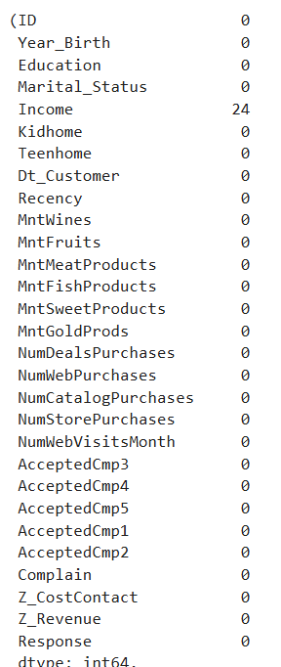

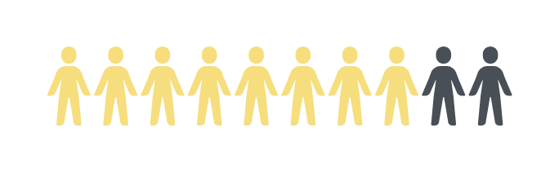
INITIAL INSIGHTS
Summary statistics (mean, median, etc.
Number of records and features & Missing values

Slide 9

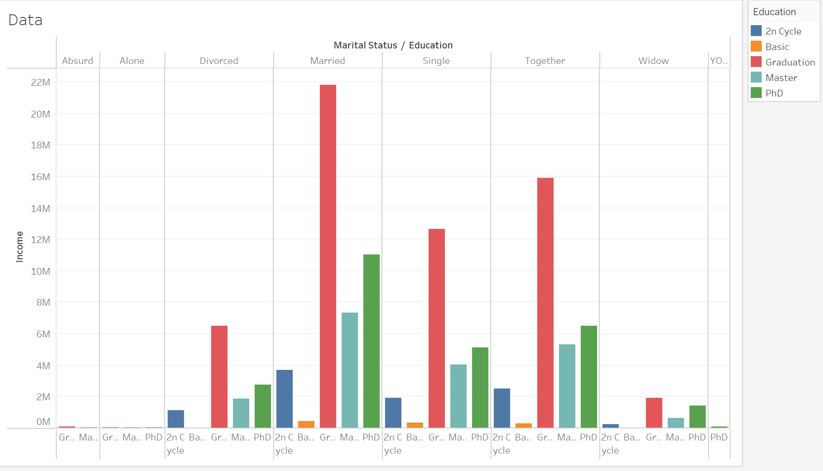
Distributions and Frequencies
Income vs Marital Status & Education
The bar chart displays income across various marital statuses and education levels. Categories include Absurd, Alone, Divorced, Married, Single, Together, and Widow. Education levels range from 2nd Cycle to PhD. The highest incomes are among married individuals with Graduation degrees, and those living together with Graduation degrees.

Slide 10
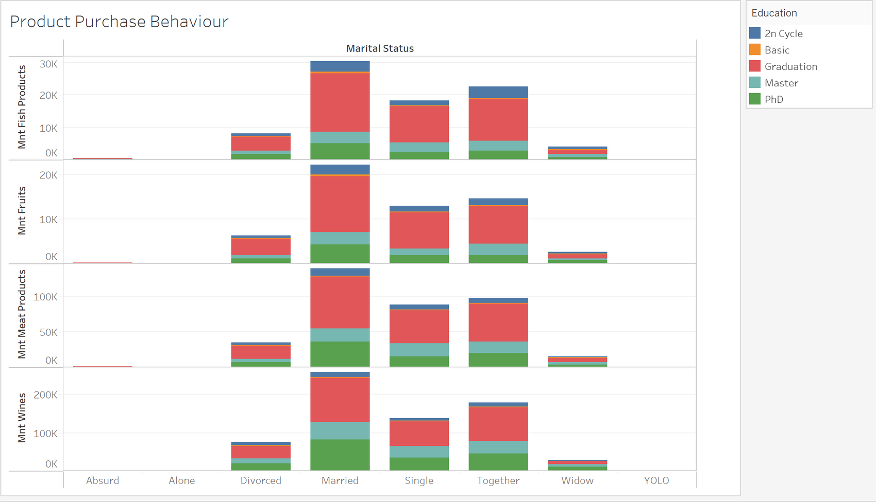
Distributions and Frequencies
The bar chart illustrates product purchase behavior segmented by marital status and education level. It includes categories such as Fish Products, Fruits, Meat Products, and Wines. Married individuals with Graduation degrees show the highest purchase levels across all product types. Other marital statuses like Divorced and Single show varying purchase levels.
Various product vs marital status & Education

Slide 11
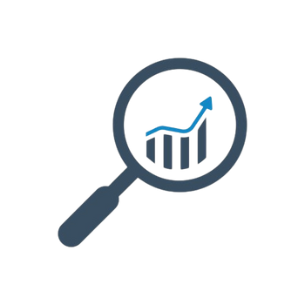



DATA PREPROCESSING
HANDLING MISSING VALUES
NORMALIZING/SCALING DATA
Features were scaled to bring all the variables to a comparable range, which is essential for clustering algorithms.
missing values were handled by imputing with median values for numerical features Income.
REMOVING OUTLIERS
Outliers were identified and removed to ensure the clustering model performs accurately.

Slide 12
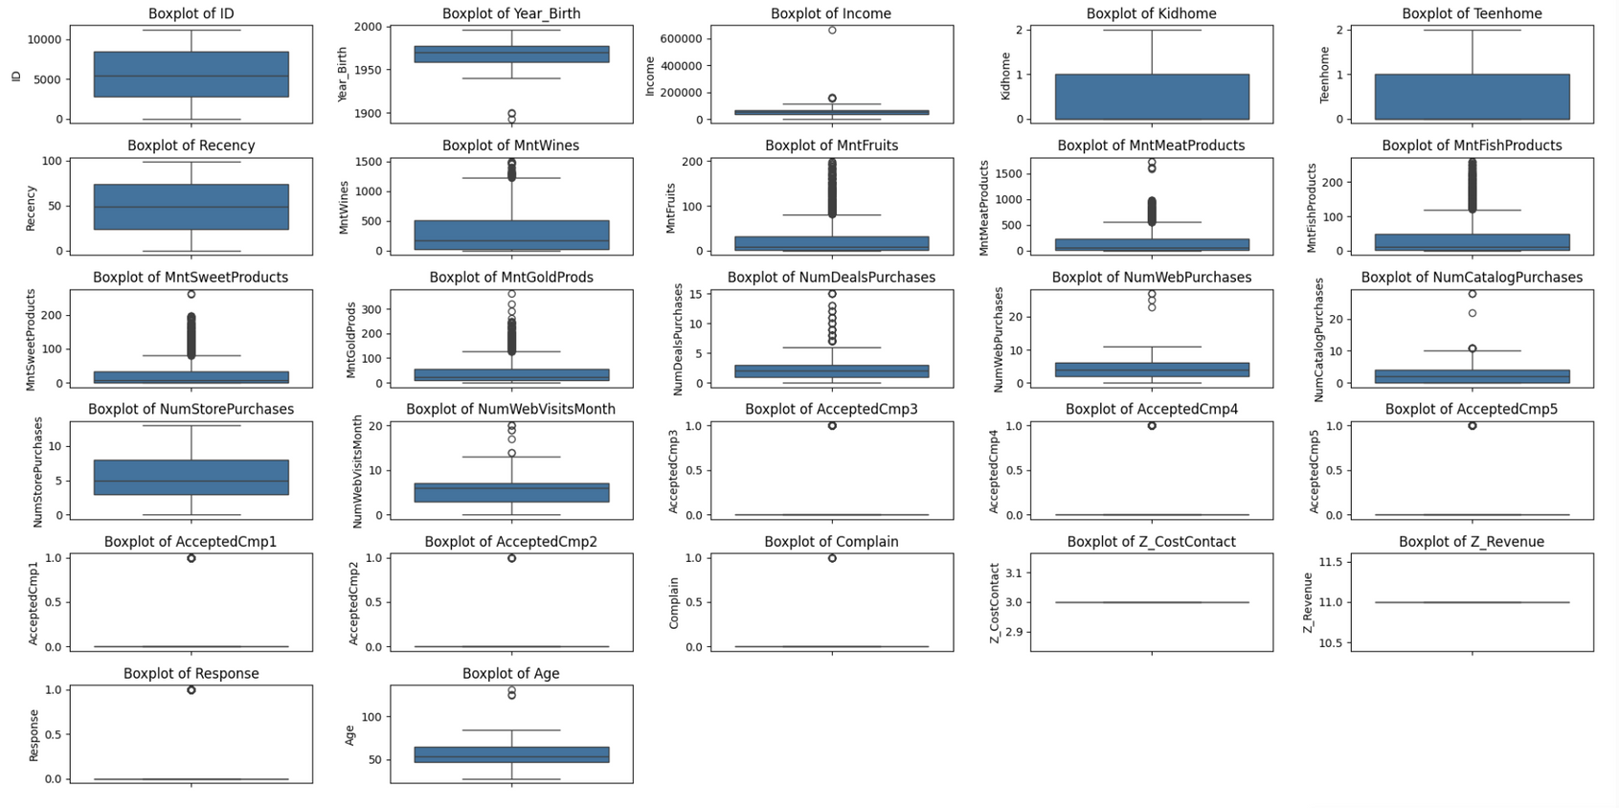
BOX PLOTS TO IDENTIFY OUTLIERS
Box plots were used to identify outliers by displaying the distribution of key features such as Income, Age, and Product Purchases. The plots highlight the median, quartiles, and potential outliers, which are values falling outside 1.5 times the interquartile range (IQR), aiding in data cleaning.

Slide 13
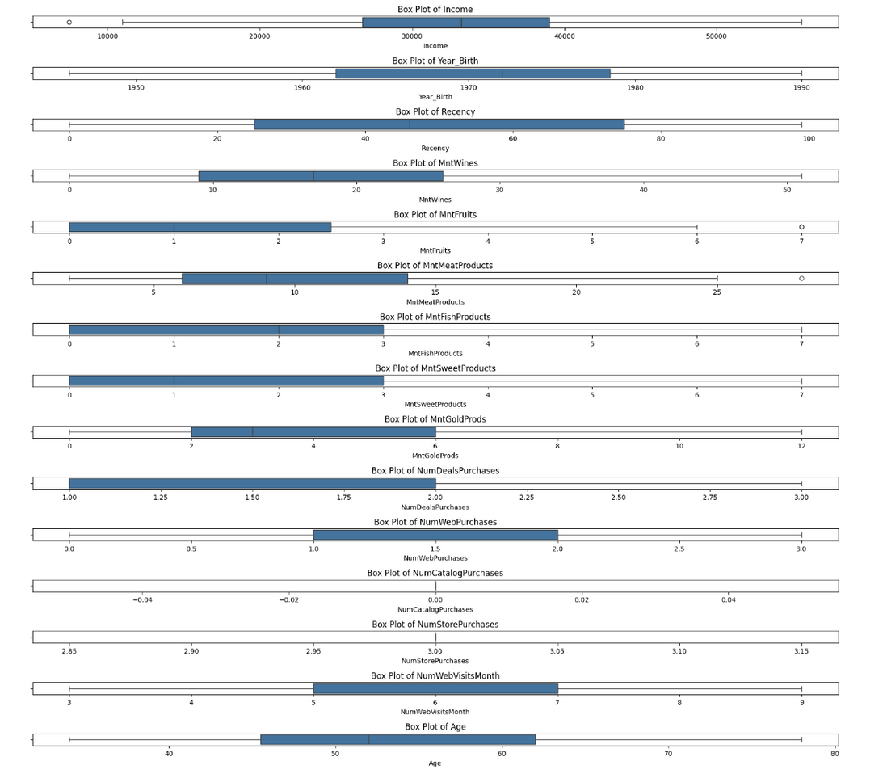
REMOVE OUTLIERS FROM EACH NUMERICAL FEATURE
To remove outliers from each numerical feature, first, calculate the Interquartile Range (IQR) for each feature. Identify values below Q1−1.5×IQR or above Q3+1.5×IQR, and filter them out. This ensures data points outside the typical range are excluded, improving data quality for analysis and modeling.

Slide 14

NORMALIZING/SCALING DATA
Scaling of numerical features in data preprocessing involves transforming the range of values to a standardized range, typically between 0 and 1 or with a mean of 0 and a standard deviation of 1. This ensures that features with different scales contribute equally to machine learning models, improving performance and convergence.

Slide 15
CLUSTERING METHODOLOGY
Steps for clustering:
Feature Selection: Choose relevant features for clustering.
Data Scaling: Standardize the features to have a mean of 0 and a standard deviation of 1.
Clustering Algorithms:
K-Means clustering
Hierarchical clustering (optional)
Evaluation:
Determine the optimal number of clusters using methods like the Elbow method
and Silhouette score.
Interpretation: Analyze the characteristics of each cluster to create customer profiles.

Slide 16
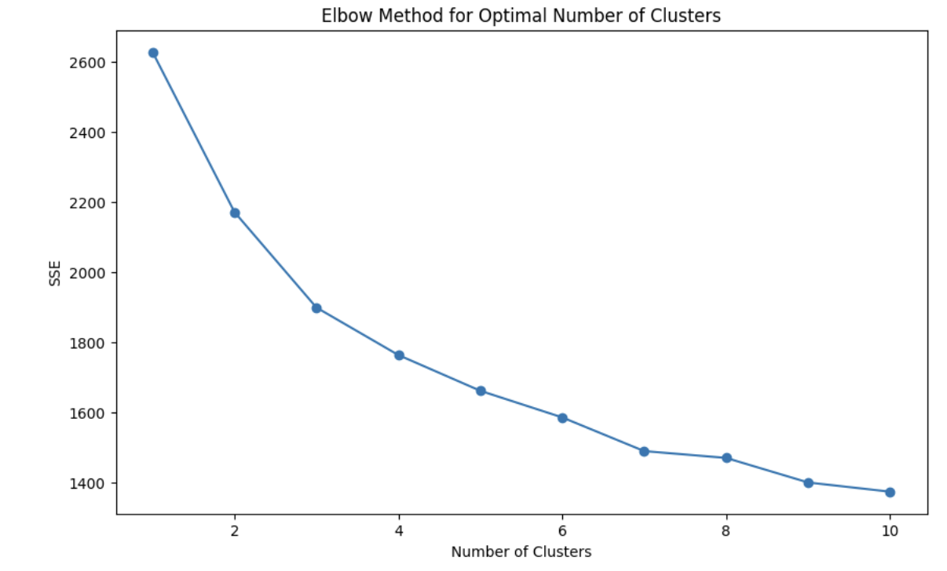
K-MEANS CLUSTERING
Explanation: Plots sum of squared distances vs. number of clusters
Visual: Elbow graph indicating optimal number of clusters (k=4)
Conclusion: Chose k=4 for further analysis
K=4

Slide 17

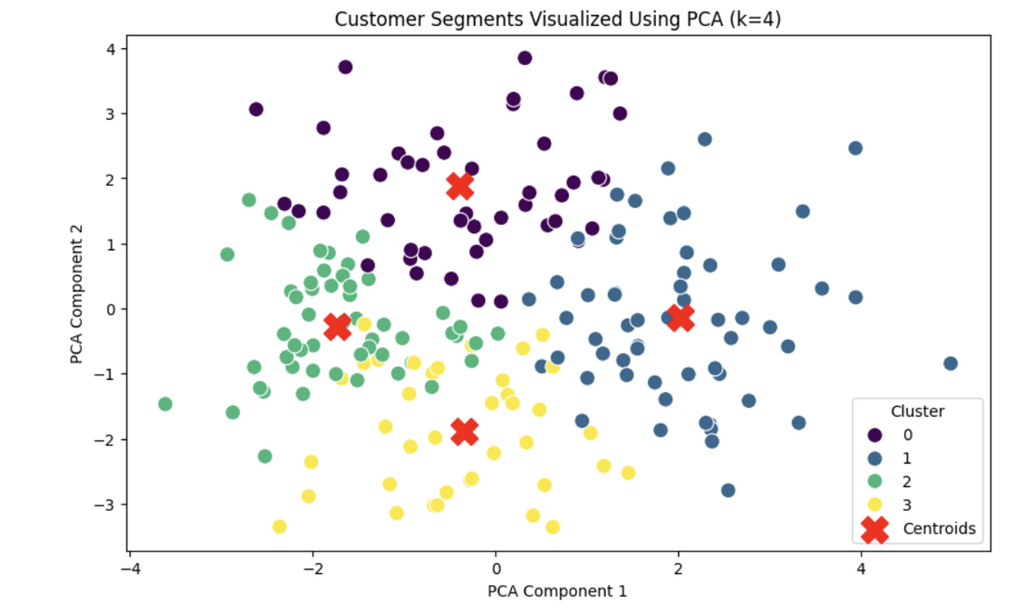

CLUSTERING RESULTS
Cluster Centroids: Display coordinates of centroids for k=4
Use PCA to reduce the features to 2 dimensions for visualization
Visual: Scatter plot of clusters
Insights: Characteristics of each cluster

Slide 18
CLASSIFICATION METHODOLOGY
Objective:
Predict customer segments for new customers
Algorithm Chosen:
Random Forest, Decision Tree etc
Steps:
Splitting the data into training and test sets
Training the classifier
Evaluating the model

Slide 19
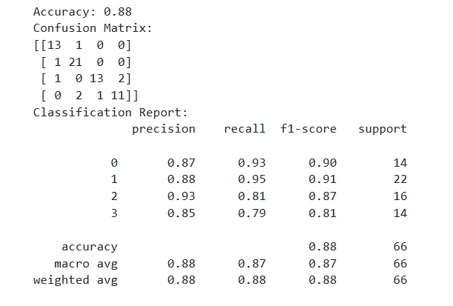

CLASSIFICATION RESULTS
Reports an accuracy of 88%.
The confusion matrix shows the model's predictions for four classes, indicating how many instances were correctly and incorrectly classified. The classification report includes detailed metrics for each class: precision, recall, f1-score, and support.
For class 0, the precision is 0.87, recall is 0.93, and f1-score is 0.90.
For class 1, these values are 0.88, 0.95, and 0.91, respectively.
The report also provides macro and weighted averages for these metrics, all of which are 0.88 for precision and 0.87-0.88 for recall and f1-score.

Slide 20
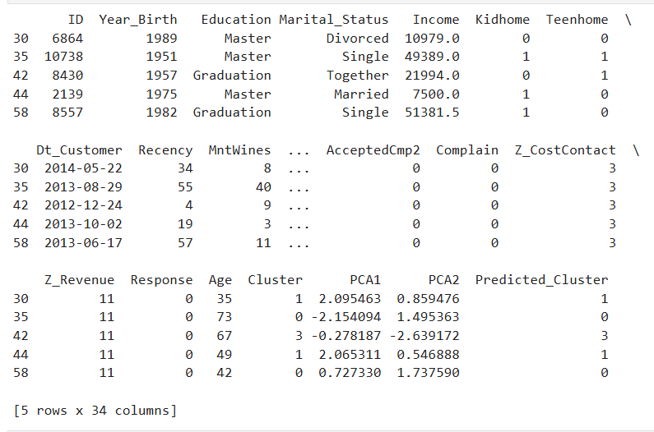
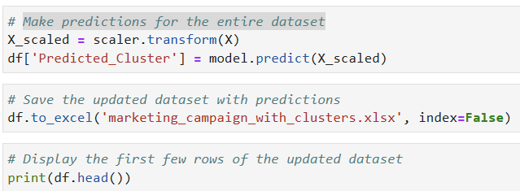

MAKE PREDICTIONS FOR THE ENTIRE DATASET
code:

Slide 21
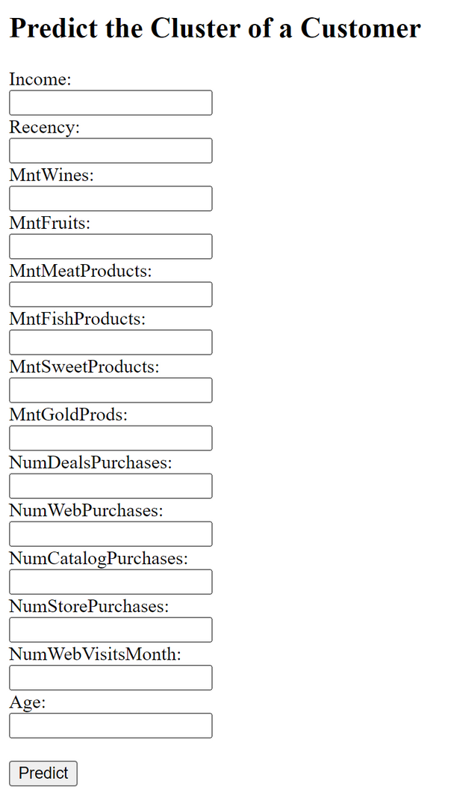

DEPLOYING THE MODEL AS A WEB APPLICATION
Integration with Flask
Link--
http://127.0.0.1:5000

Slide 22
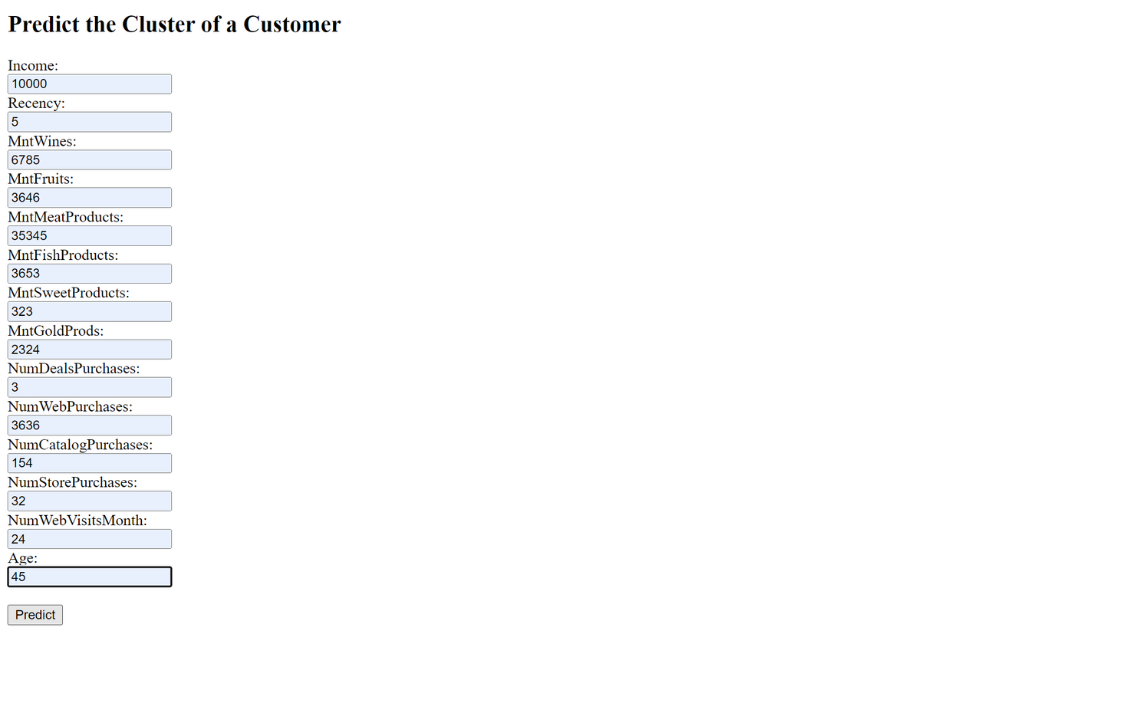
DEPLOYMENT RESULT

Slide 23


CHALLENGES AND SOLUTIONS
Challenges:
Handling missing data
Choosing the right number of clusters
Ensuring classifier accuracy
Solutions:
Imputation techniques
Elbow method and silhouette score
Hyperparameter tuning for classifier

Slide 24


NEXT STEPS
Further Improvements:
Explore other clustering algorithms (e.g., DBSCAN)
Incorporate more features
Future Work:
Enhance the web application
Continuous model monitoring and updating

Slide 25

CONCLUSION
In this project, we successfully developed a robust customer segmentation and classification system using clustering and machine learning techniques. Our extensive exploratory data analysis provided valuable insights into customer behavior. The K-Means clustering algorithm identified distinct customer segments, while the classification model demonstrated strong performance with high accuracy, precision, and recall. Deploying the application using Flask ensures easy accessibility and usability. This system enables targeted marketing strategies, improving customer engagement and business outcomes. Future enhancements can include real-time data integration and advanced predictive analytics to further refine customer insights and drive business growth.

Slide 26


